Slide 1
Hypnotic Beef
Team Red Solo Cup: Kevin Xiong

Slide 2
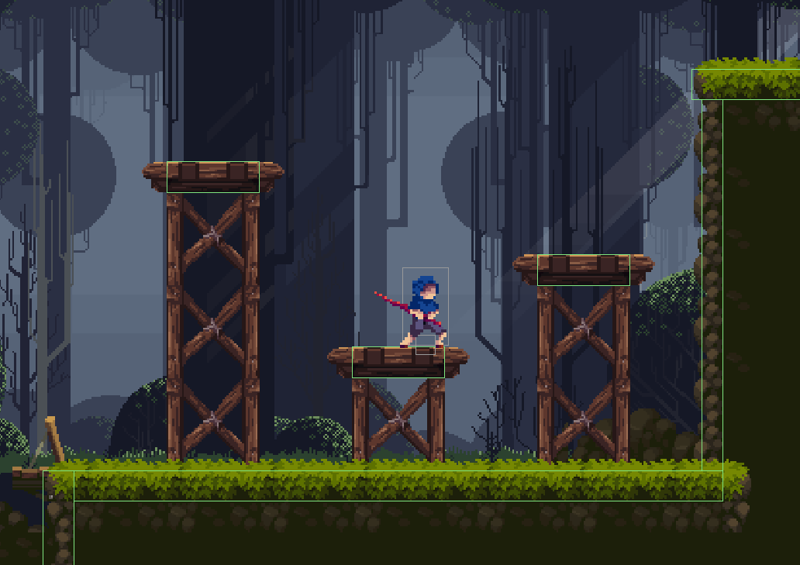
A simple platformer
A game created from scratch
Made with various tech (libgdx framework)
OpenGL
Box2d
FreeType
Etc.

Slide 3
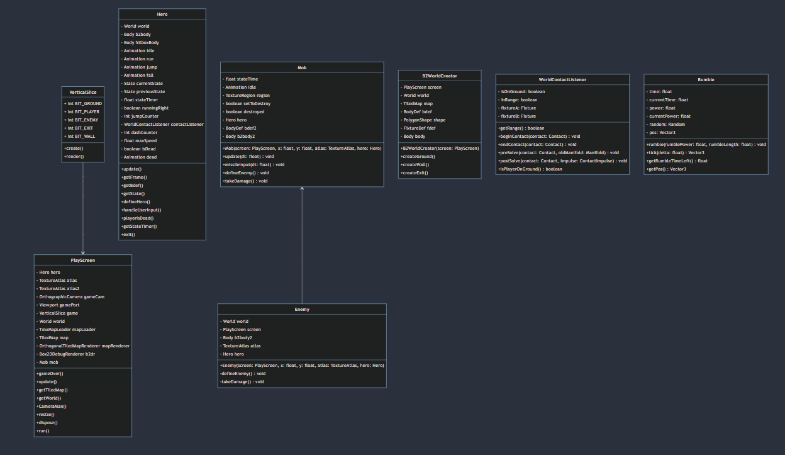
UML Design

Slide 4
UML Summary
VerticalSlice acts similar to a stage similar to JavaFX.
PlayScreen takes all the components of what makes a game and combines them into one location (Physics, Characters, Textures, Music, etc.)
B2World and WorldContactListener handle collisions.
Rumble creates camera effects such as camera shake.
Enemy implements components to what makes a enemy.
Mob class fleshes out a certain character.
Player defines our character and physics.

Slide 5
What I Have Learned
Game design is a lengthy and complex process that requires a lot of work and attention to detail.
Solo developers have to wear many hats, such as artist/animator, music composer, programmer, director, and more.
To cope with these challenges, it is crucial to learn how to create prototypes effectively.
Understanding the difference between low and high-level game engines is essential for choosing the right tools for the job.
Meta-data plays a significant role in game development, as it helps developers keep track of their progress and make informed decisions.
Bigger projects require better organization to ensure a smooth and successful outcome.
Math plays an important role!!

Slide 6
Demo Time
Beware of Loud Sounds

